Slide 1
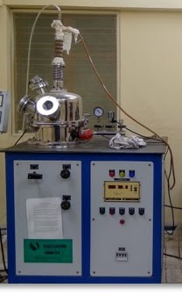
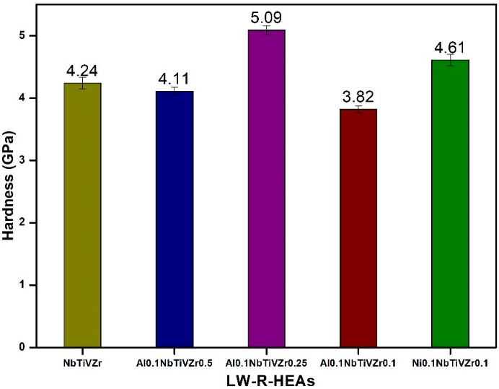

Design and development of light weight refractory high entropy alloys (LW-R-HEAs) for defence and aerospace applications Korrayi Roja Rani ^{1*}, Shibayan Roy ¹ ¹ Department of Materials Science Center, Indian Institute of Technology Kharagpur, West Bengal, India.
Processing: Melting-casting
Abstract:
Novel equi- or near equi-atomic multicomponent alloys have gained a lot of attention in recent years due to its simple phase and microstructure formation ability. Since, these alloys consisting of 5 or more metals and named as “High entropy alloys (HEAs)” due to high randomness. Refractory high entropy alloys (R-HEAs) are one of the classes obtained from high entropy alloys and consisting with refractory metallic elements. Most commonly used refractory elements are V, Cr, Zr, Nb, Mo, Hf, Ta and W for both conventional refractory and refractory high entropy alloys. In order to decreasing the density of the refractory high entropy alloys with promising yield strength and ductility (or strain to fracture), elements like Ti and Al have used. Currently, Fe-, Ni- and Co- base super alloys have mostly occupied the industrial and aircraft applications due to their high temperature mechanical properties. However, super alloys are not able to meet promising yield strength at elevated temperature applications. Though conventional refractory alloys are showing moderate impact on yield strength from room temperature to 1000$℃$, but showing detrimental effect in ductility. A special attention initiated towards R-HEAs to address the issues generated from super and conventional refractory alloys. Several scientific reports suggests that R-HEAs possess the ability to produce with high temperature yield strength, ductility over super and conventional refractory alloys by forming simple BCC or HCP structure. This research work involved with the design and development of light weight refractory high entropy (LW-R-HEAs) and their structure-processing-property correlation.
Structure: Dendtritic microstrcutre
Property: Hardness
Figure: Structure-property-processing correlation

